Slide 1
Smart Cap
By CANIETI

Slide 2
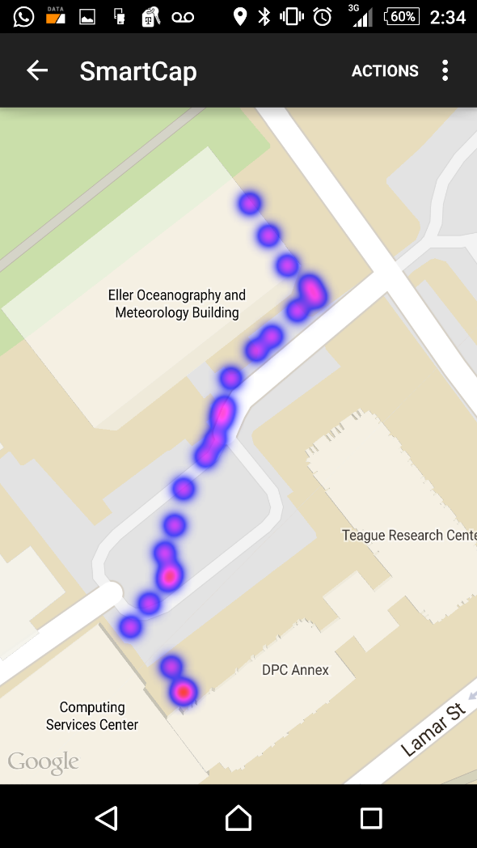
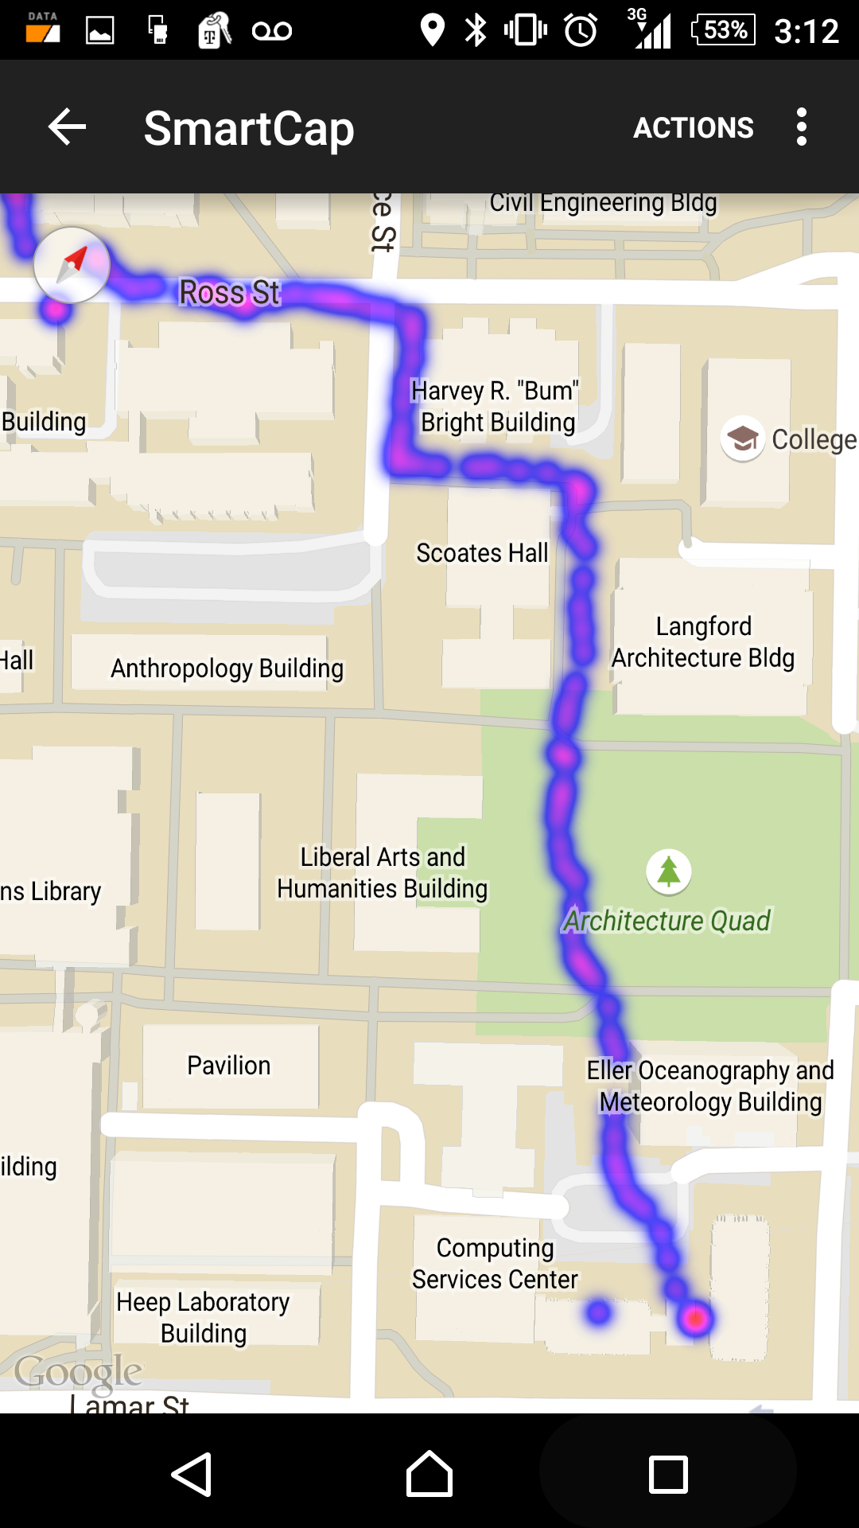
First Samples
Registering location only

Slide 3
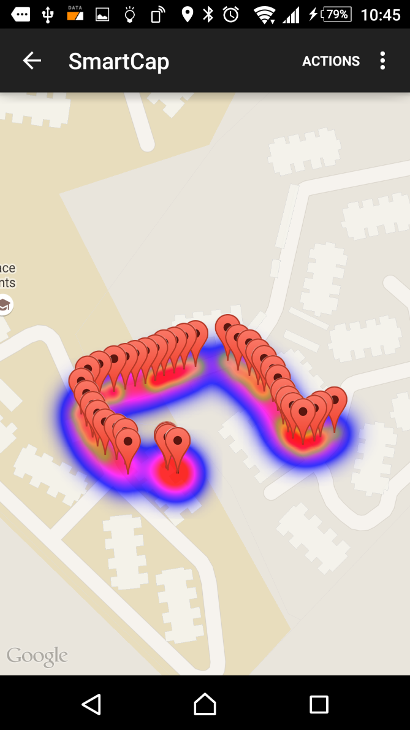
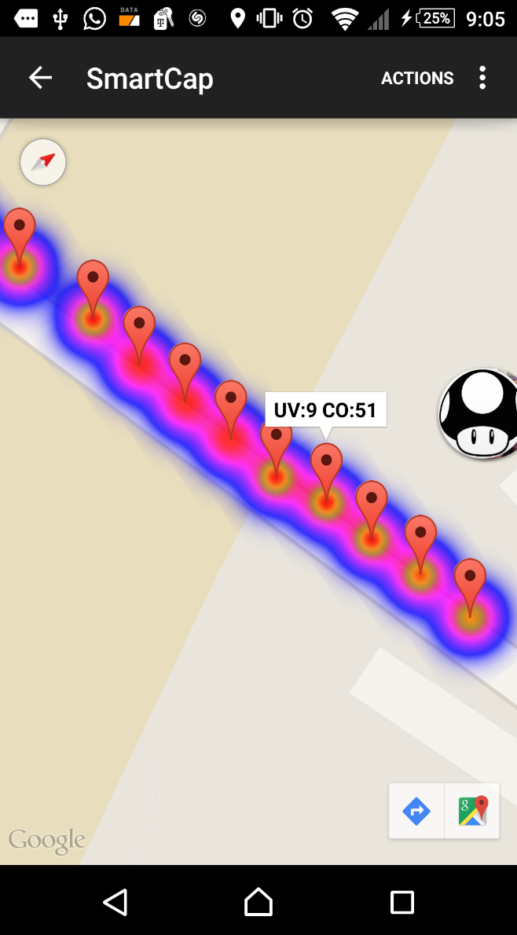
Real Samples
Registering values from simulated sensors
(Photo resistor, and potentiometer)

Slide 4
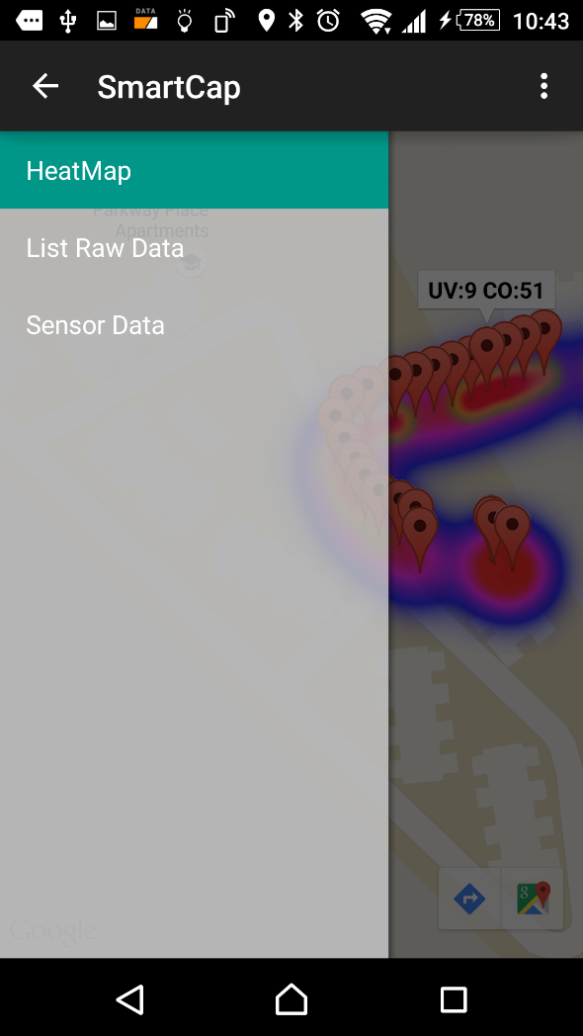
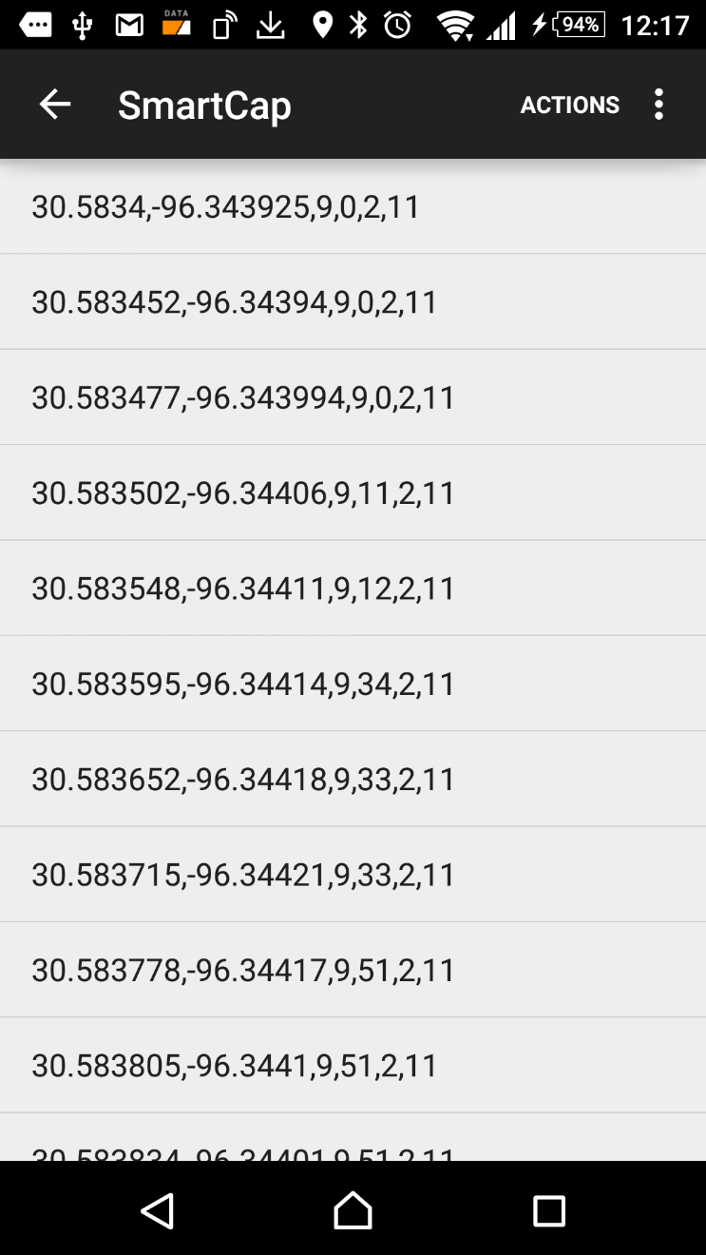
Menu Data

Slide 5
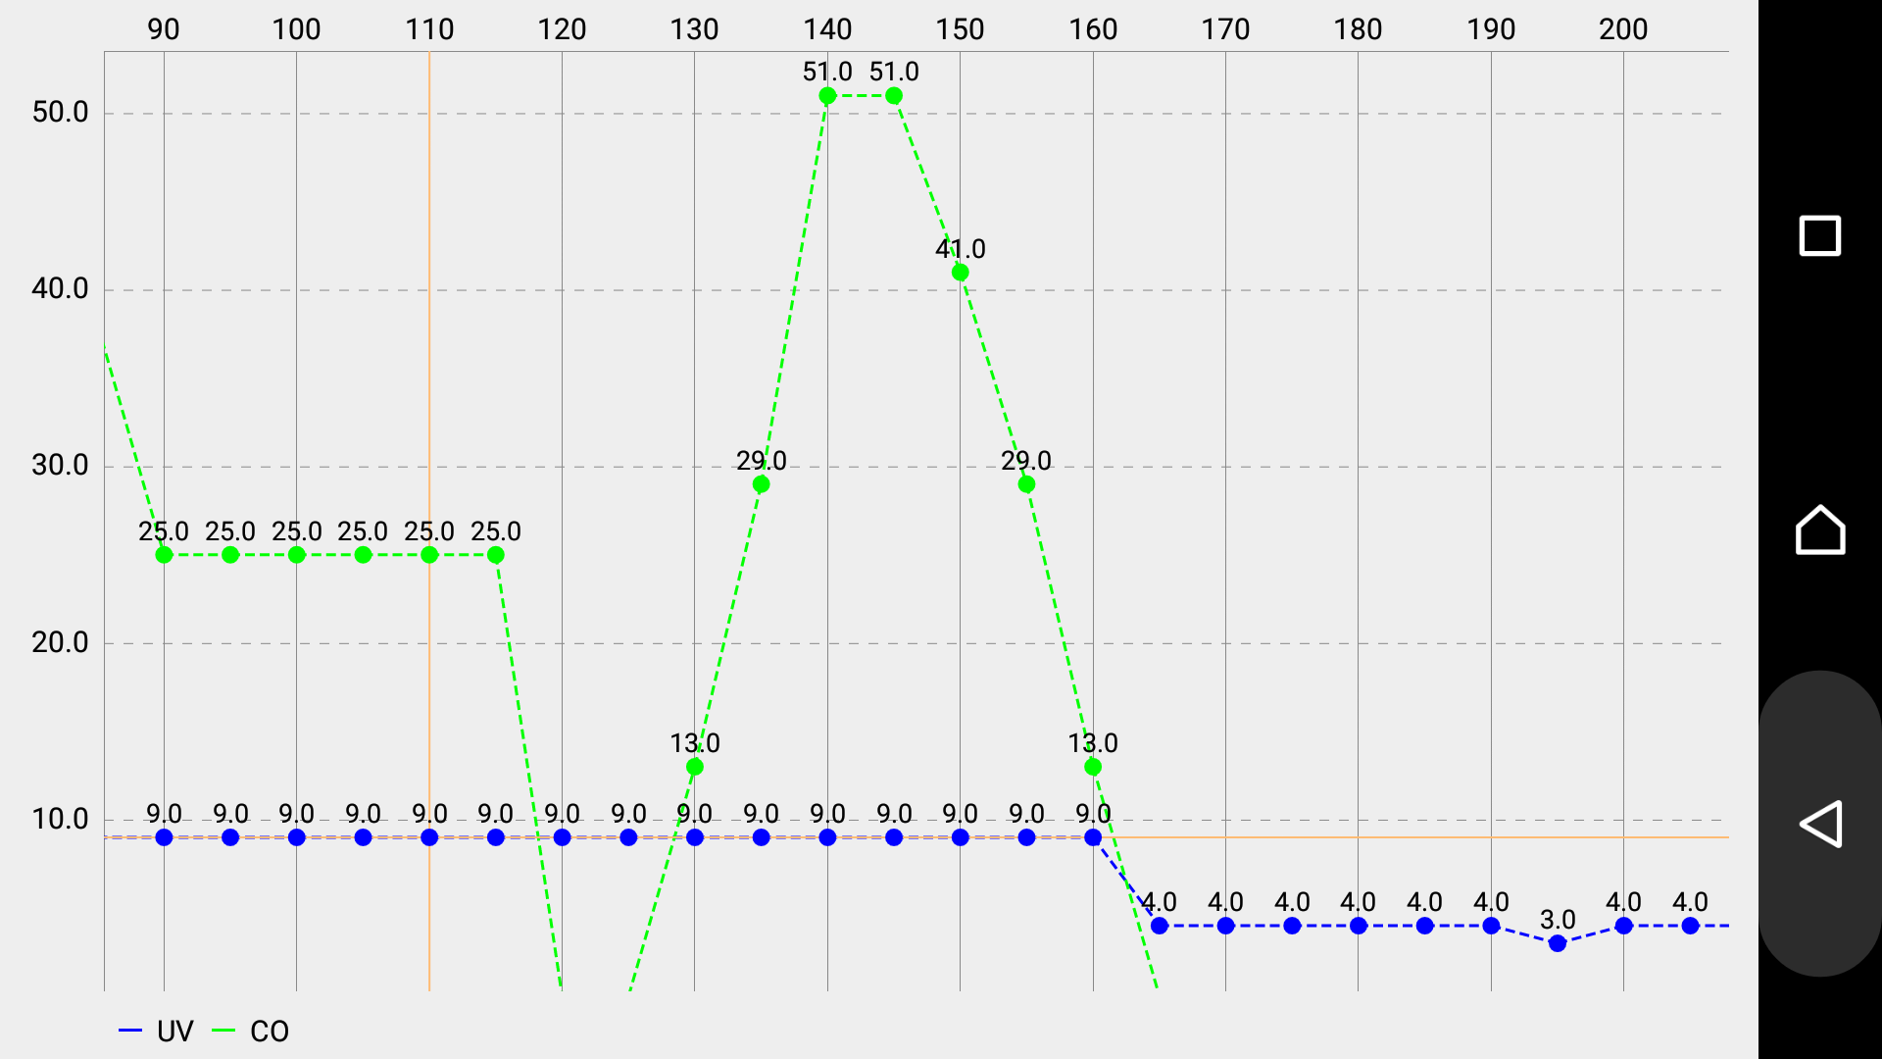
Graph of UV and air quality index

Slide 6
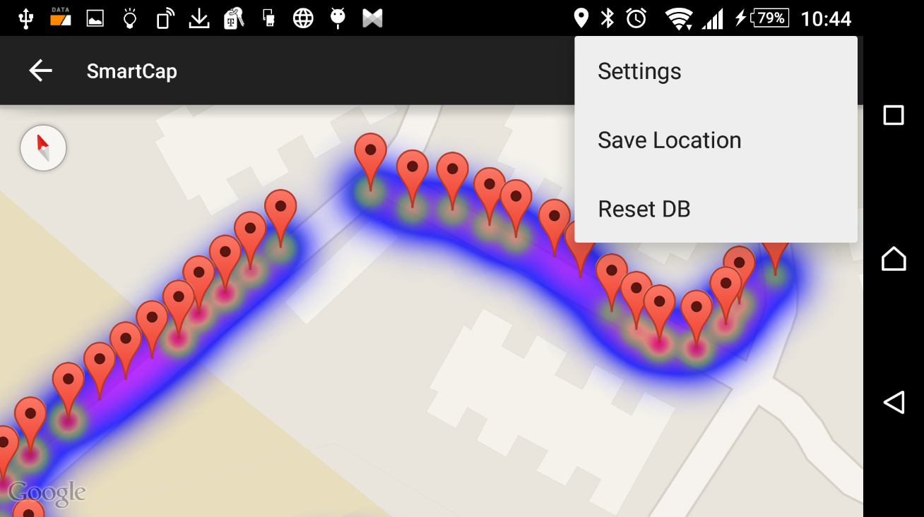
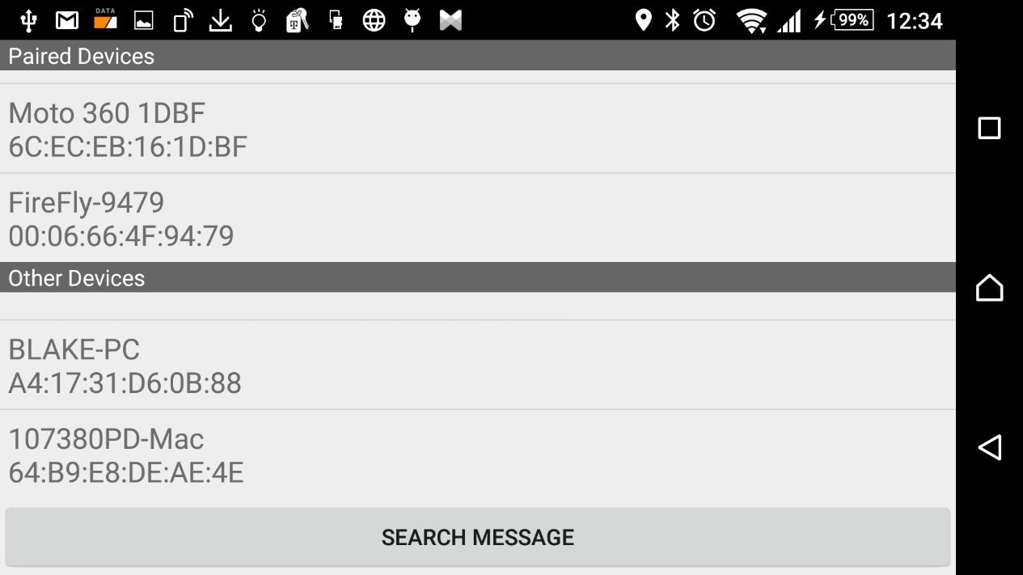
Bluetooth Connection
Options

Slide 7
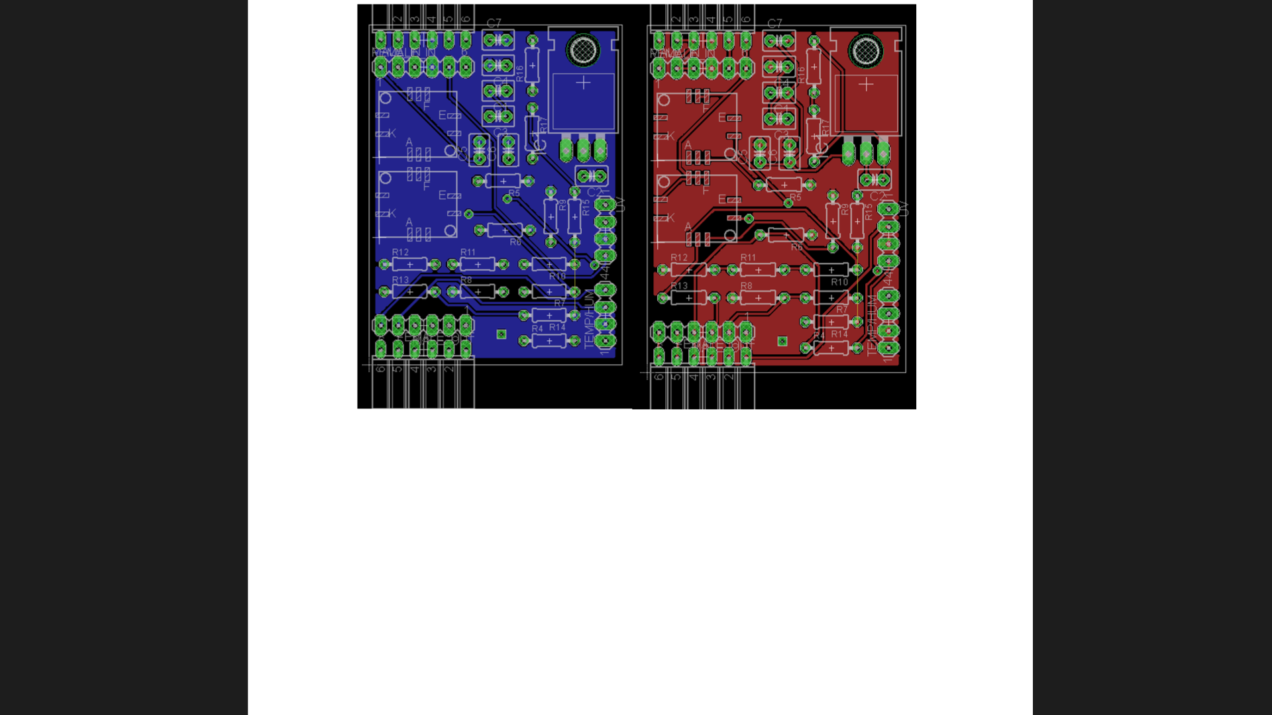
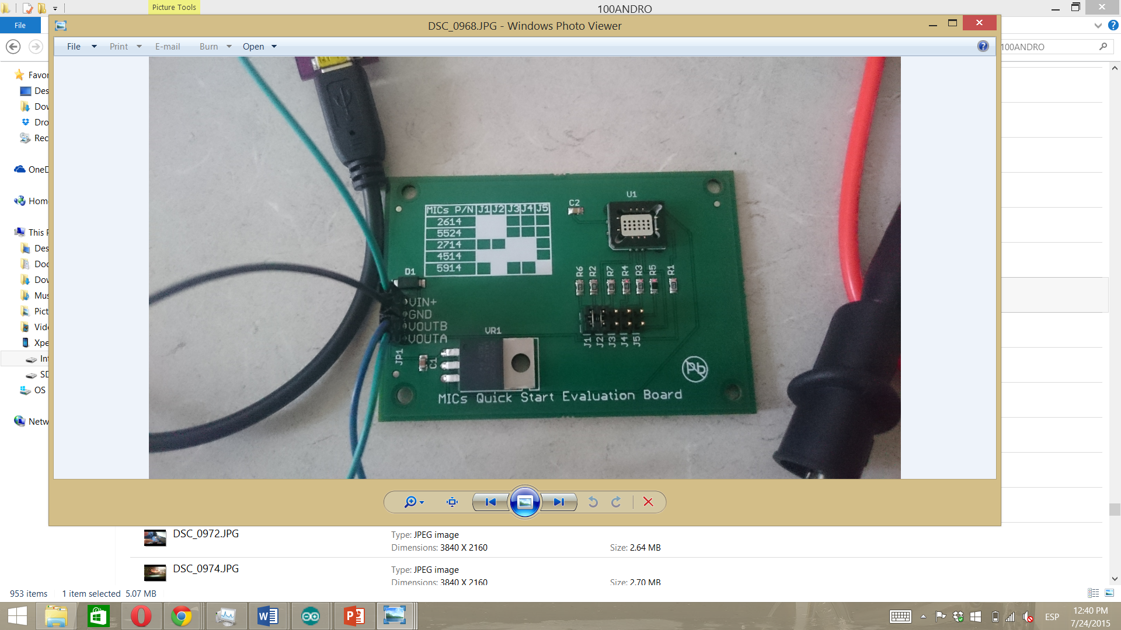
Circuit board
Sensor Connection
O3, NO2, CO
Waiting for it! (EIC)

Slide 8
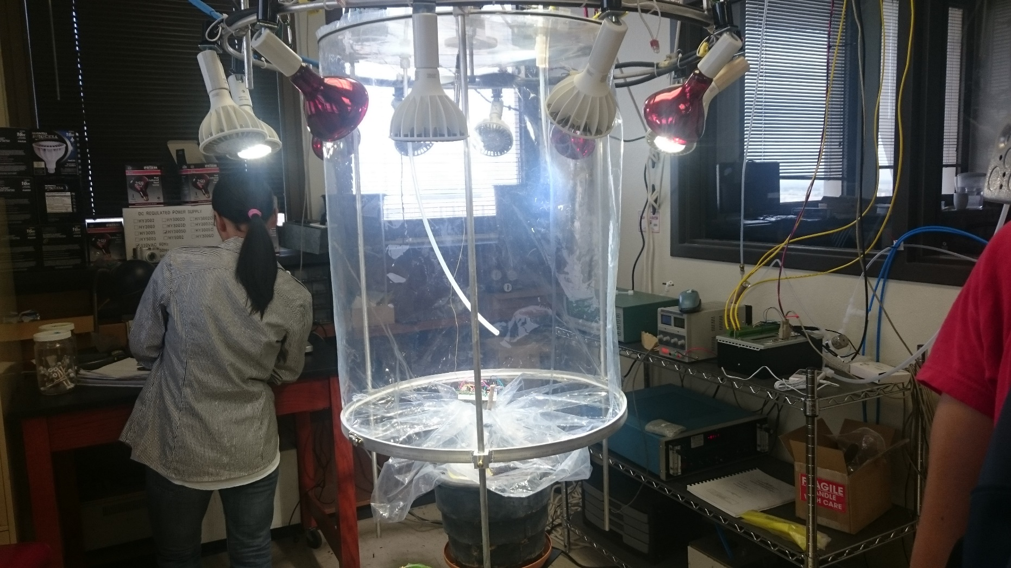
Sensor Calibration
Dr. Gunnar W. Schade - Department of Atmospheric Sciences

